Slide 1
Mitosis Event Detection and Quantification
Student: Gerda Bortsova
Supervisors: Dr. Lichao Wang, Dr. Carsten Marr

Slide 2
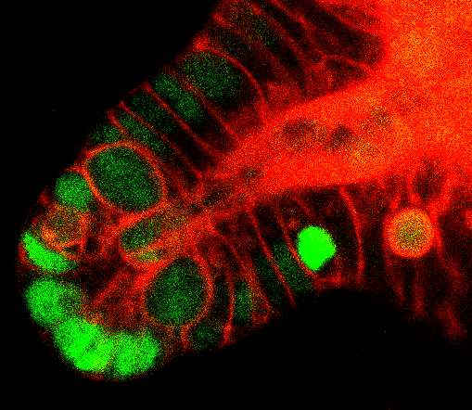
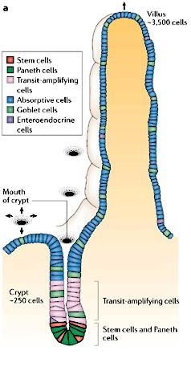
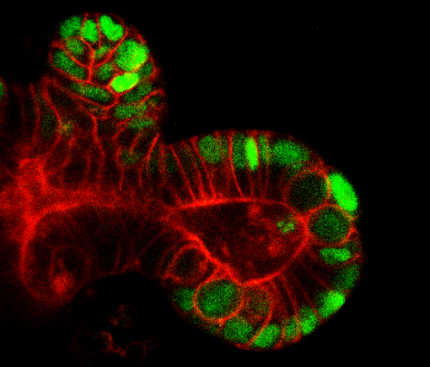
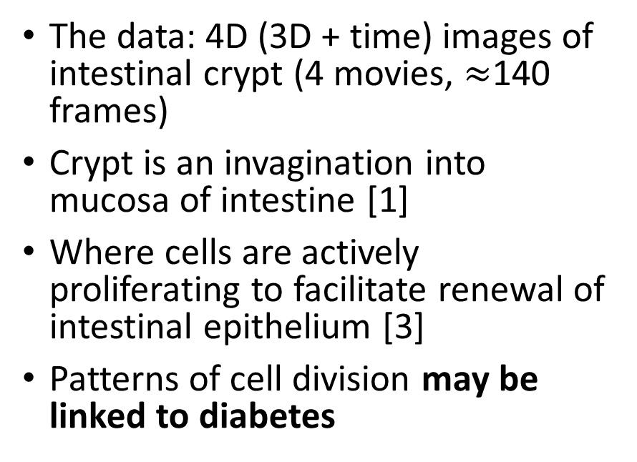
Introducing the problem I
The data: 4D (3D + time) images of intestinal crypt (4 movies, $≈$140 frames)
Crypt is an invagination into mucosa of intestine [1]
Where cells are actively proliferating to facilitate renewal of intestinal epithelium [3]
Patterns of cell division may be linked to diabetes
The distribution of epithelial cell types in the mammalian small intestine. [2]
The data: central slices.
[1] Barker et al. 2008. The intestinal stem cell. Genes & Dev. [2] Crosnier et at. 2006. Organizing cell renewal in the intestine: stem cells, signals and combinatorial control. Nature Reviews Genetics. [3] Yeung et al. 2011. Regulation of self-renewal and differentiation by the intestinal stem cell niche. Cellular and Molecular Life Sciences.
Notes:
In my project I have 4D images (3D + time) of intestinal crypt
Crypt is a kind of cavity in intestinal mucosa
It is covered with cells which are actively dividing
Pattern of this division might be liked to diabetes

Slide 3
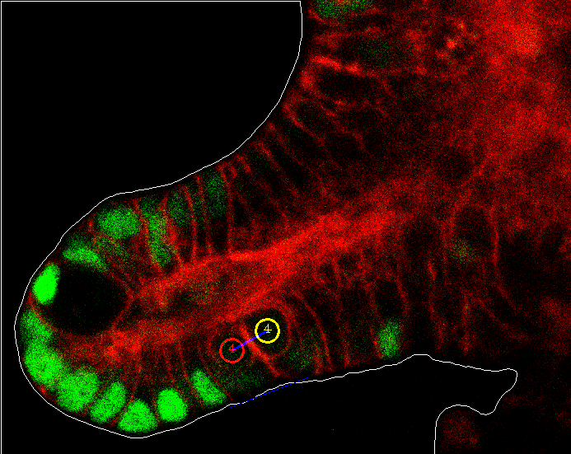
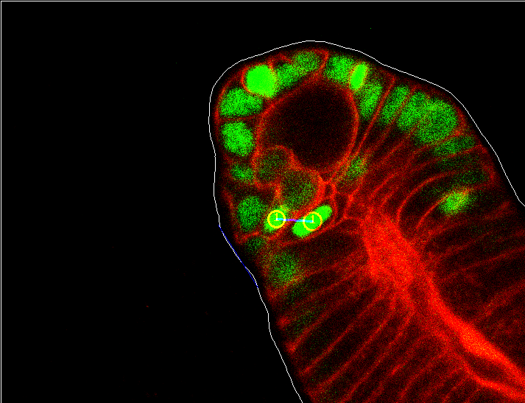
Introducing the problem II
The task: aid biologists to measure a statistics of angle between cells arisen from division and the crypt surface.
Almost parallel
Rather perpendicular

Slide 4

Introducing the problem III
The project parts:
Automatic extraction of crypt surface
Developing a method to measure angle between the crypt surface and daughter cells
Detection of mitosis events

Slide 5
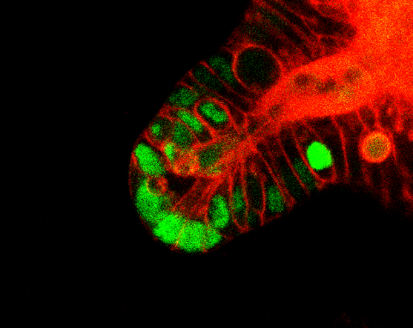
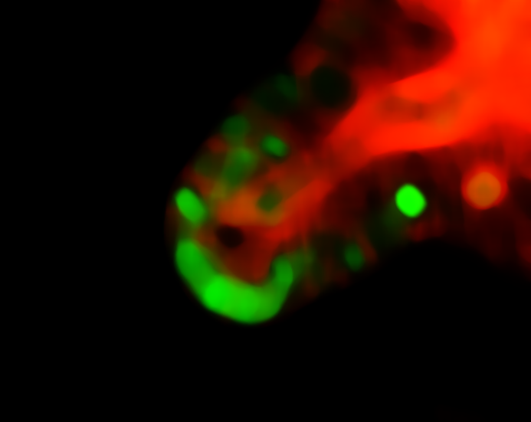
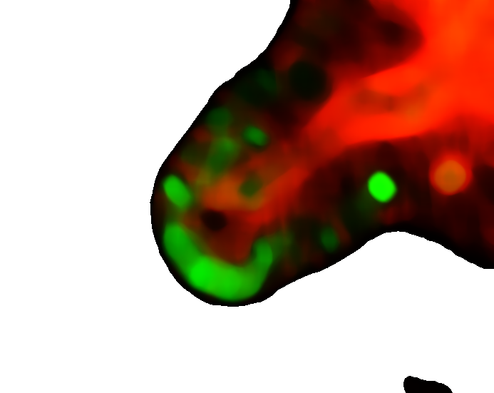
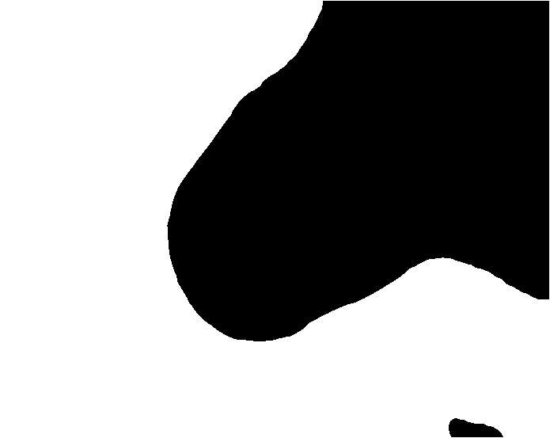
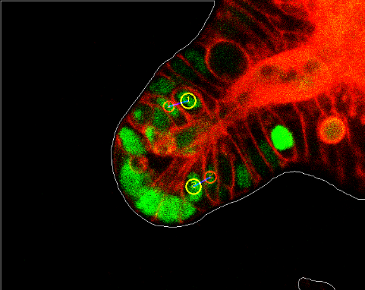
Extraction of crypt surface
Statistical Shape Models (SSM) [4] was considered.
Solved by Flood Fill algorithm [5] and subsequent extraction of the contour [6].
[4] Cootes et al. 2000. Statistical Models of Appearance for Computer Vision. [5] Flood Fill on Wikipedia: https://en.wikipedia.org/wiki/Flood_fill [6] Suzuki. 1985. Topological structural analysis of digitized binary images by border following. Computer Vision, Graphics, and Image Processing.
Notes:
With Dr. Wang we firstly considered to use SSM. However, as the background is plain-black, we can apply Flood Fill algorithm. We take black pixel in the border and expand until we hit not black. From this white and black mask we extract the border.

Slide 6
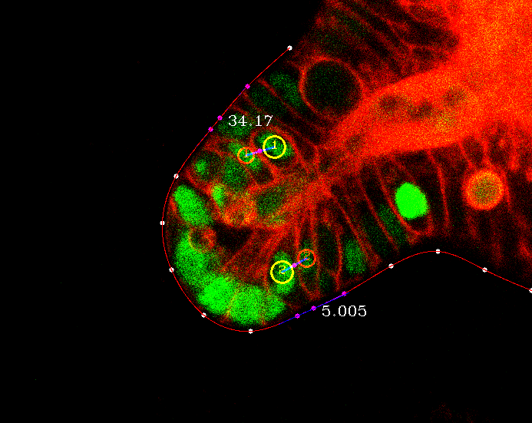
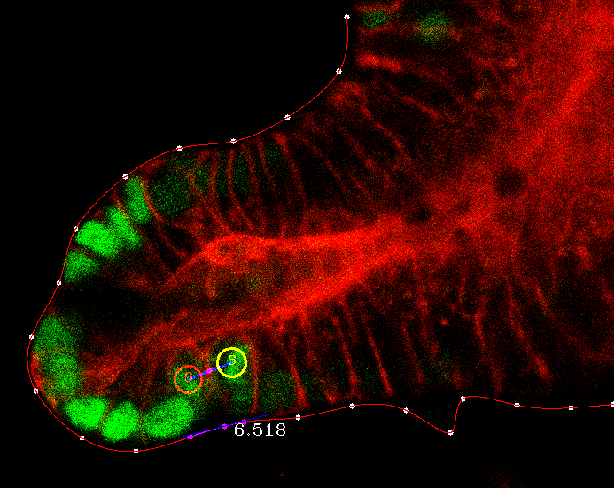
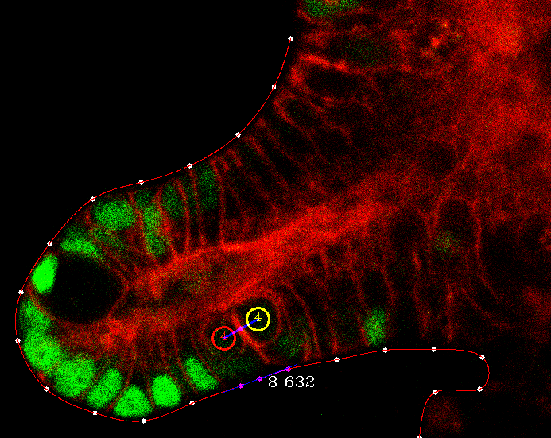

The method for measuring angle
Sample points of equal distance from the crypt
Interpolate using cubic spline [7]
Calculate an angle between:
a line connecting daughter cells and
tangent line at the point of the crypt closest to a central point of a line segment connecting the daughters
[7] Cubic Spline on Wolfram: http://mathworld.wolfram.com/CubicSpline.html

Slide 7

The project parts
Automatic extraction of crypt surface
Developing a method to measure angle between the crypt surface and daughter cells
Detection of mitosis events
Notes:
The most difficult part which is left is detection of events of cell division.

Slide 8
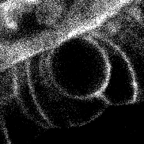
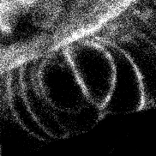
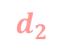
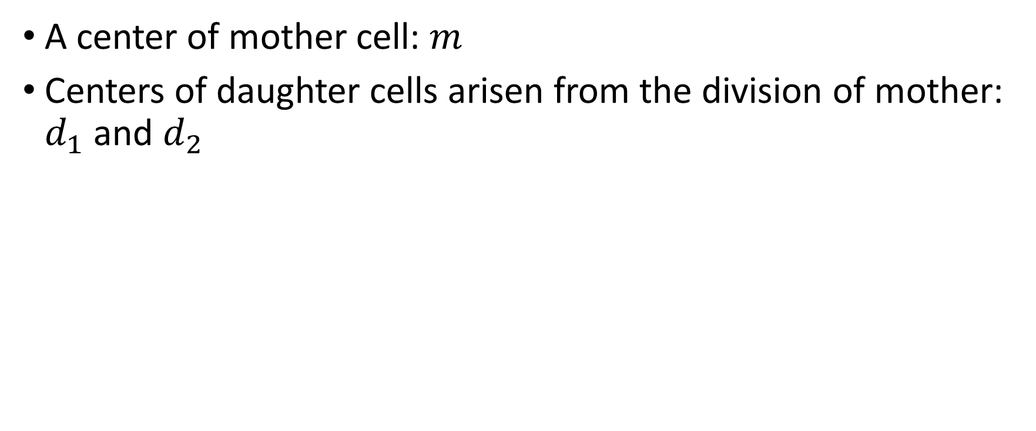
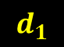

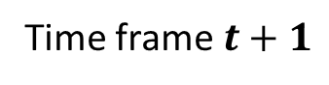
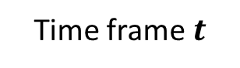
What is a mitosis event?
A center of mother cell: $m$
Centers of daughter cells arisen from the division of mother: $d_{1}$ and $d_{2}$
$$m$$
$$d_{1}$$
$$d_{2}$$
Time frame $t$
Time frame $t+1$
Notes:
Daughters are always in the time frame following right after mother’s time frame

Slide 9
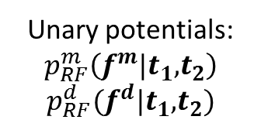
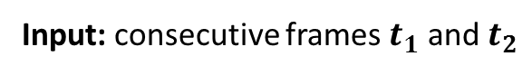
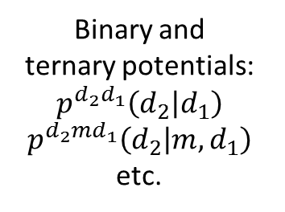
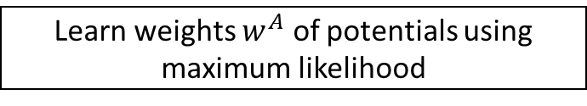
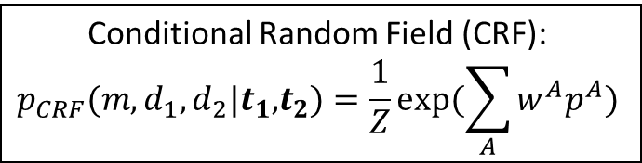
Detection of mitosis: the workflow
Input: consecutive frames $t_{1}$ and $t_{2}$
Extract feature sets $f^{m}$ and $f^{d}$
Model higher-order potentials (e.g. $p^{{d_{2}d}_{1}}\left(d_{2} | d_{1}\right)$)
Train two random forests:
one for mother, one for daughter
Estimate parameters of models
Unary potentials:
$$p_{RF}^{m}\left(f^{m}|t_{1}\text{,}t_{2}\right)$$
$$p_{RF}^{d}(f^{d}|t_{1}\text{,}t_{2})$$
Binary and
ternary potentials:
$$p^{{d_{2}d}_{1}}\left(d_{2} | d_{1}\right)$$
$$p^{d_{2}md_{1}}\left(d_{2} | m, d_{1}\right)$$
etc.
Conditional Random Field (CRF):
$$p_{CRF}(m, d_{1},d_{2}|t_{1}\text{,}t_{2})=\frac{1}{Z}exp⁡(\sum_{A}{w^{A}p^{A}})$$
Alternative:
Bayes’ theorem
Learn weights $w^{A}$ of potentials using maximum likelihood
Output: sets of tuples $(m, d_{1},d_{2})$ with $p_{CRF}\left(m, d_{1},d_{2} | t_{1},t_{2}\right)>threshold$
Notes:
Here is the workflow of mitosis detection. Suppose I have consecutive frame t1 and t2 as input
The first thing I do I extract two sets of features: one which is relevant for mother cell detection, another for daughter
Then I train two random forest classifiers separately for mother detection, separately for daughter.
At the same time I’ll consider higher order potentials, that is dependencies between cell locations. I’ll model them with normal distribution. Then I’ll estimate distribution parameters for each potential.
Now when I have this components I can model joint probability of mother and two daughters.
I have two alternatives to do so. A more naïve and simpler one is to use Bayes theorem
Another and more powerful alternative is to use graphical models, in particular conditional random field.
My joint distribution is exponent of a weighted sum of potentials. Weights will be learned with maximum likelihood
The output is tuples of three points with joint prob. Higher than some threshold.

Slide 10
Detection of mitosis: the workflow
Input: consecutive frames $t_{1}$ and $t_{2}$
Extract feature sets $f^{m}$ and $f^{d}$
Model higher-order potentials (e.g. $p^{{d_{2}d}_{1}}\left(d_{2} | d_{1}\right)$)
Train two random forests:
one for mother, one for daughter
Estimate parameters of models
Unary potentials:
$$p_{RF}^{m}\left(f^{m}|t_{1}\text{,}t_{2}\right)$$
$$p_{RF}^{d}(f^{d}|t_{1}\text{,}t_{2})$$
Binary and
ternary potentials:
$$p^{{d_{2}d}_{1}}\left(d_{2} | d_{1}\right)$$
$$p^{d_{2}md_{1}}\left(d_{2} | m, d_{1}\right)$$
etc.
Conditional Random Field (CRF):
$$p_{CRF}(m, d_{1},d_{2}|t_{1}\text{,}t_{2})=\frac{1}{Z}exp⁡(\sum_{A}{w^{A}p^{A}})$$
Alternative:
Bayes’ theorem
Learn weights $w^{A}$ of potentials using maximum likelihood
Output: sets of tuples $(m, d_{1},d_{2})$ with $p_{CRF}\left(m, d_{1},d_{2} | t_{1},t_{2}\right)>threshold$

Slide 11
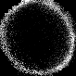
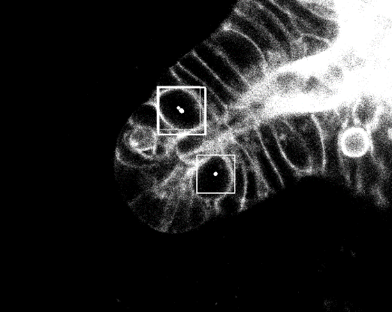
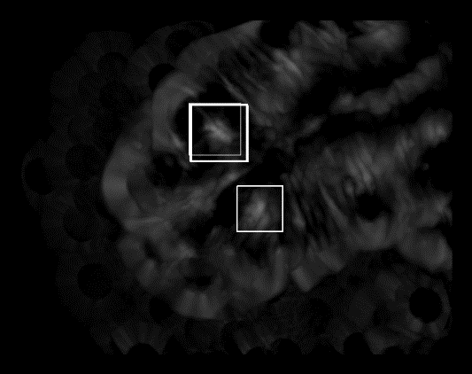
Features: template matching [8]
The algorithm:
Choosing so-called template: image containing only the object
At each point of target image calculate a similarity measure (I took correlation coefficient) of a local patch and the template
Problems:
Cells may have different sizes and not exactly circular shape -> search only for a single template, but for it’s linear transformations
Gives false positives (and negatives) -> use in combination with other features
Set of templates
Mother cells detection
Correlation coefficient
[8] Brunelli. 2009. Template Matching Techniques in Computer Vision: Theory and Practice.
Notes:
---
Mother cells have nearly round shape. I can just extract a cell from one image like this and measure a correlation between this template and a region of interest.
One problem with this is that mothers may not be exactly round. So I may include transformations of this one template as templates.

Slide 12
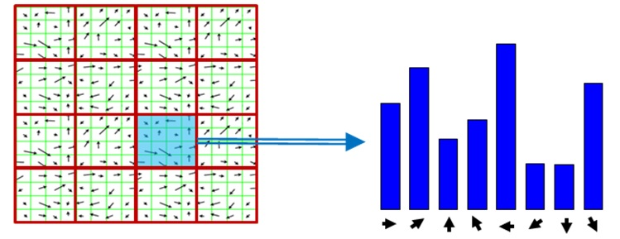
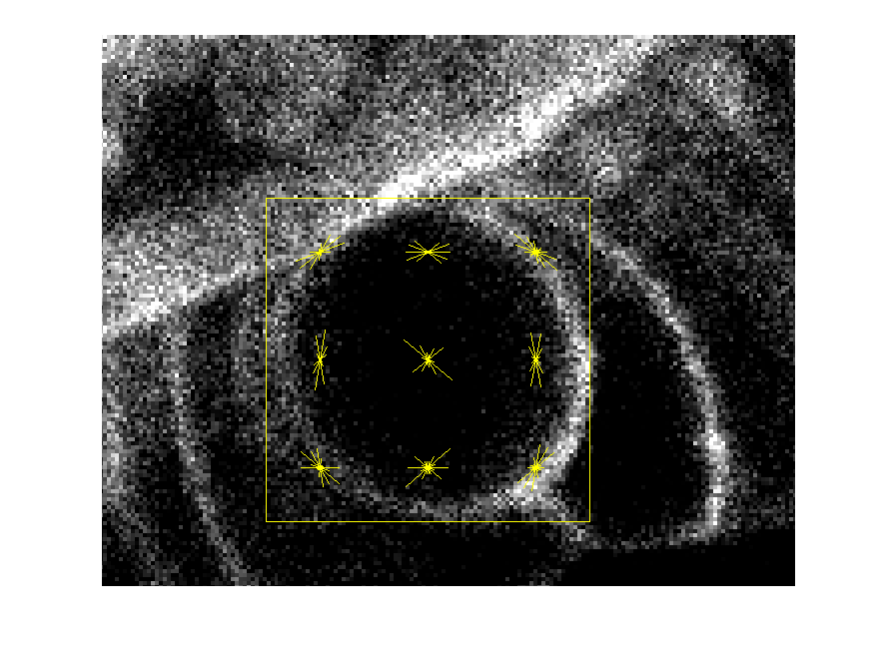
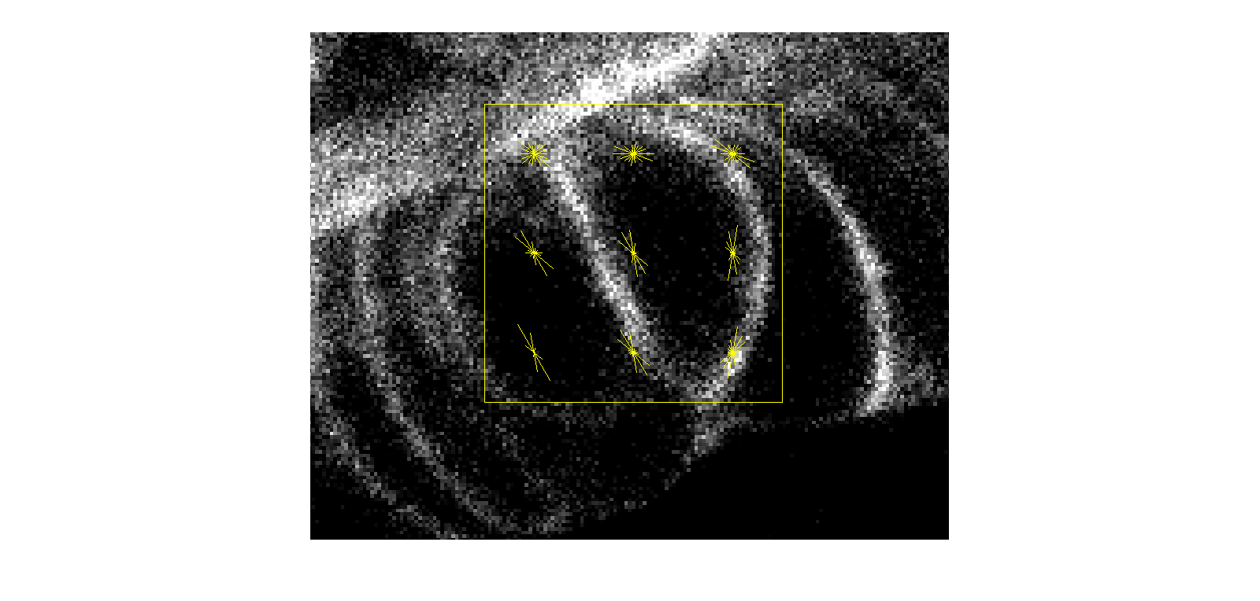
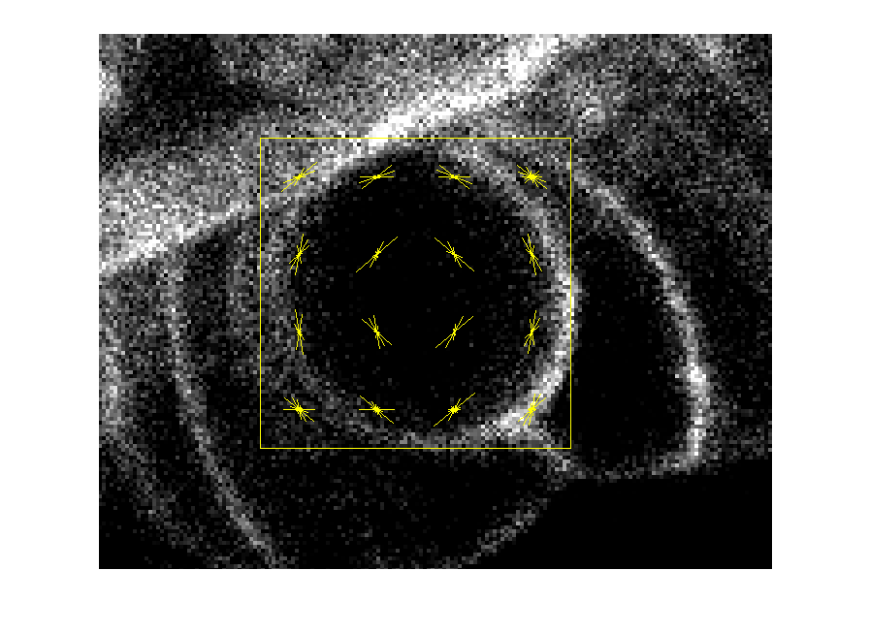
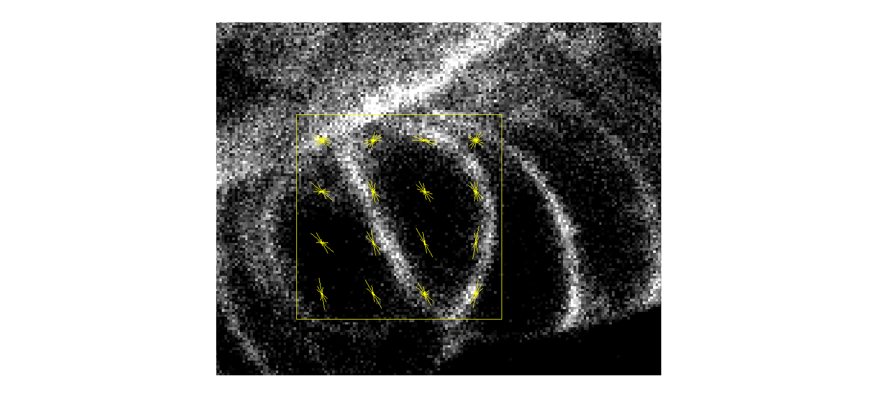
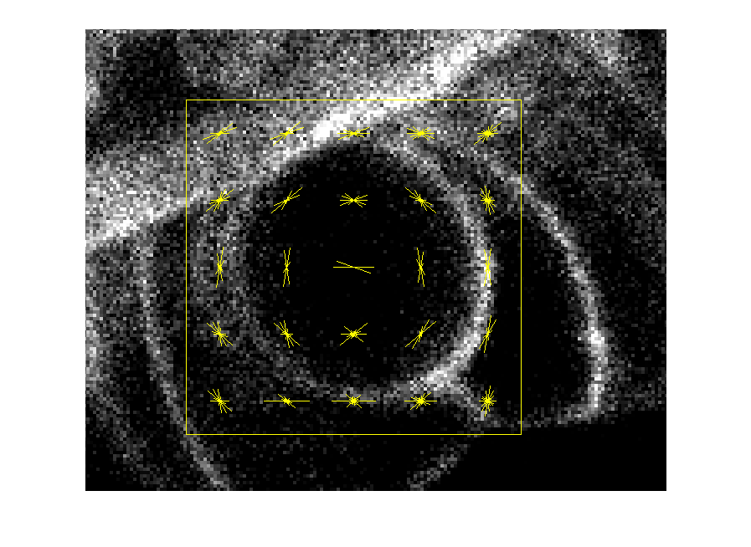
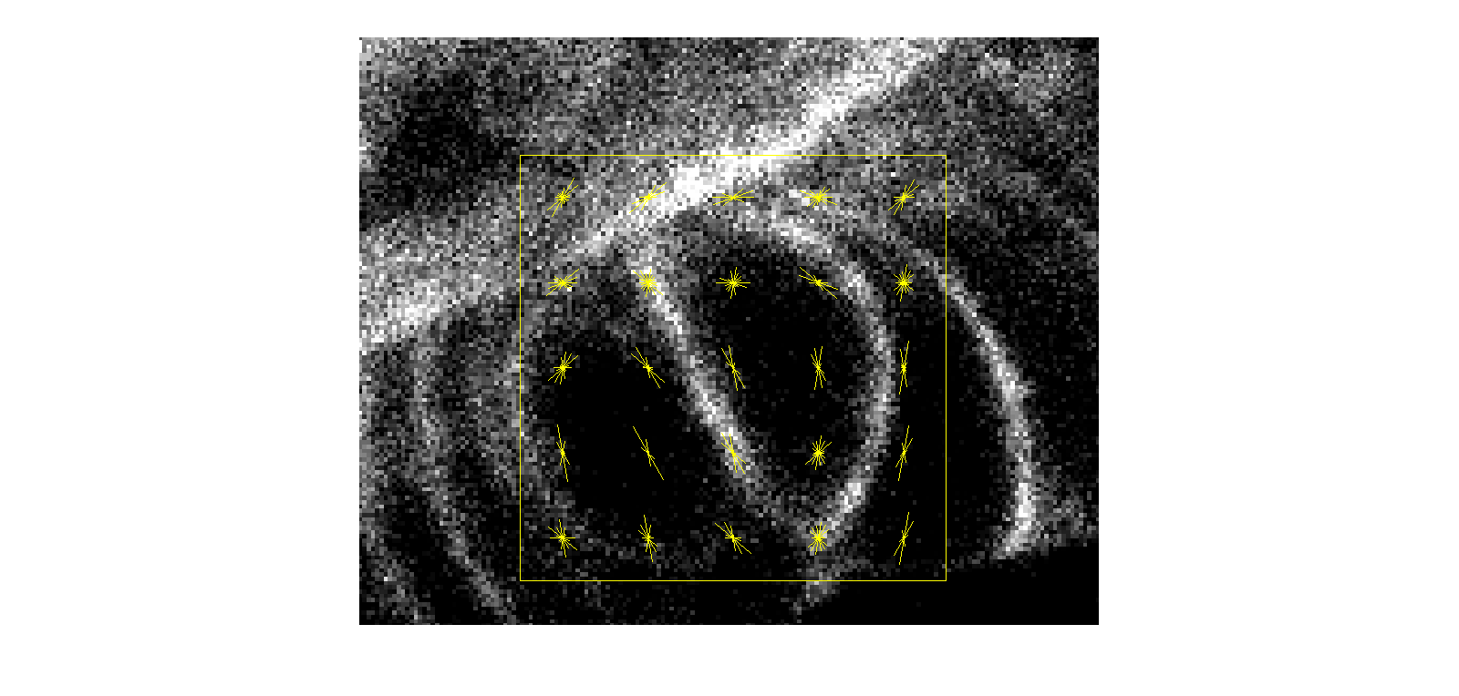
Features: histogram of oriented gradients (HOG) [9]
The algorithm:
Compute gradient at each pixel of the patch
Each gradient votes for a bin in orientation-based
histogram
Problems:
Not rotation-invariant
Choose number of blocks:
Number of parameters, Descriptiveness
[9] Dalal et al. 2005. Histograms of oriented gradients for human detection. In Computer Vision and Pattern Recognition, 2005. CVPR 2005.
Notes:
In HOG, a set of features is extracted from the patch based on gradients at each point. One problem is that it’s not rotation invariant. Another is to choose number of blocks over which to take HOG.

Slide 13
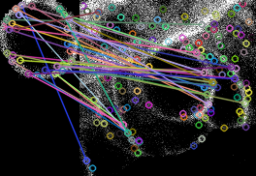
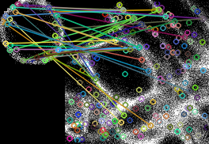
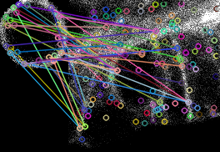
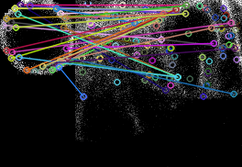
Features: SIFT (Scale-Invariant Feature Transform) [10]
The algorithm:
Finds interesting points (keypoints) in both source and target images
Finds closest points on the target image to points on the source by comparing their HOGs
Problems: is not suitable for this task, as cell is a homogeneous object
(Trying to find template on the image it was taken from.)
[10] Lowe. 2004. Distinctive image features from scale-invariant keypoints. International Journal of Computer Vision.
Notes:
Finds discriminative points on both training and testing images and then establishes a matching. But for this task is not suitable, as cell is a homogenuous object, it doesn’t have so much of discriminative points.

Slide 14
Detection of mitosis: the workflow
Input: consecutive frames $t_{1}$ and $t_{2}$
Extract feature sets $f^{m}$ and $f^{d}$
Model higher-order potentials (e.g. $p^{{d_{2}d}_{1}}\left(d_{2} | d_{1}\right)$)
Train two random forests:
one for mother, one for daughter
Estimate parameters of models
Unary potentials:
$$p_{RF}^{m}\left(f^{m}|t_{1}\text{,}t_{2}\right)$$
$$p_{RF}^{d}(f^{d}|t_{1}\text{,}t_{2})$$
Binary and
ternary potentials:
$$p^{{d_{2}d}_{1}}\left(d_{2} | d_{1}\right)$$
$$p^{d_{2}md_{1}}\left(d_{2} | m, d_{1}\right)$$
etc.
Conditional Random Field (CRF):
$$p_{CRF}(m, d_{1},d_{2}|t_{1}\text{,}t_{2})=\frac{1}{Z}exp⁡(\sum_{A}{w^{A}p^{A}})$$
Alternative:
Bayes’ theorem
Learn weights $w^{A}$ of potentials using maximum likelihood
Output: sets of tuples $(m, d_{1},d_{2})$ with $p_{CRF}\left(m, d_{1},d_{2} | t_{1},t_{2}\right)>threshold$

Slide 15
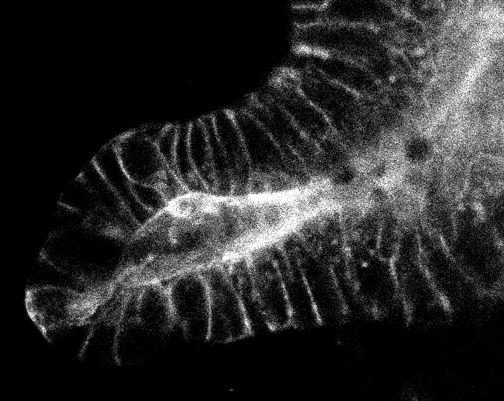
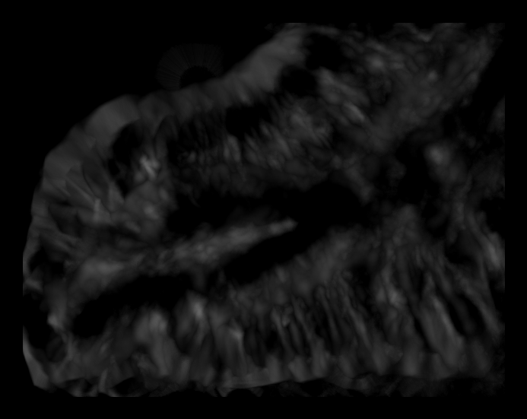
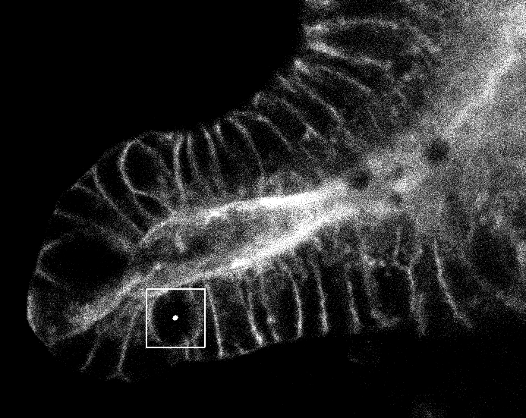
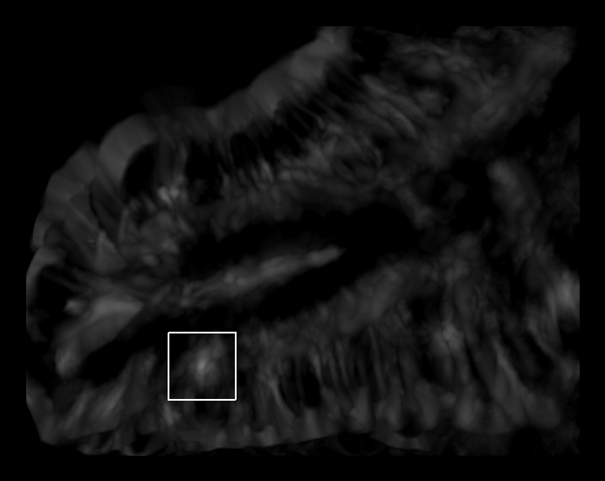
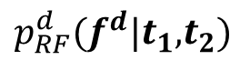

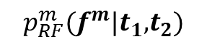
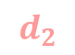


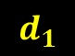


Training classifier to learn unary potentials
Extract discriminative features: template matching, HOG, color-based features
Train two random forest [11] classifiers: for mother-background and for daughter-background classification
Ambiguity
$$t_{2}$$
$$p_{RF}^{d}(f^{d}|t_{1}\text{,}t_{2})$$
$$t_{1}$$
$$p_{RF}^{m}(f^{m}|t_{1}\text{,}t_{2})$$
$$d_{2}$$
?
$$d_{1}$$
$$d_{2}$$
$$m$$
$$d_{1}$$
[11] Bishop 2006. Pattern Recognition and Machine Learning.
Notes:
The output of a classifier is a uniary potential, that is probability of (in this case) finding daughter at a particular point.
The problem is that we have two daughter cells on the same image, and for instance, two maxima of this probability map are not corresponding to true location.

Slide 16
Detection of mitosis: the workflow
Input: consecutive frames $t_{1}$ and $t_{2}$
Extract feature sets $f^{m}$ and $f^{d}$
Model higher-order potentials (e.g. $p^{{d_{2}d}_{1}}\left(d_{2} | d_{1}\right)$)
Train two random forests:
one for mother, one for daughter
Estimate parameters of models
Unary potentials:
$$p_{RF}^{m}\left(f^{m}|t_{1}\text{,}t_{2}\right)$$
$$p_{RF}^{d}(f^{d}|t_{1}\text{,}t_{2})$$
Binary and
ternary potentials:
$$p^{{d_{2}d}_{1}}\left(d_{2} | d_{1}\right)$$
$$p^{d_{2}md_{1}}\left(d_{2} | m, d_{1}\right)$$
etc.
Conditional Random Field (CRF):
$$p_{CRF}(m, d_{1},d_{2}|t_{1}\text{,}t_{2})=\frac{1}{Z}exp⁡(\sum_{A}{w^{A}p^{A}})$$
Alternative:
Bayes’ theorem
Learn weights $w^{A}$ of potentials using maximum likelihood
Output: sets of tuples $(m, d_{1},d_{2})$ with $p_{CRF}\left(m, d_{1},d_{2} | t_{1},t_{2}\right)>threshold$
Notes:
That’s why I have to include higher order potentials into the model.

Slide 17
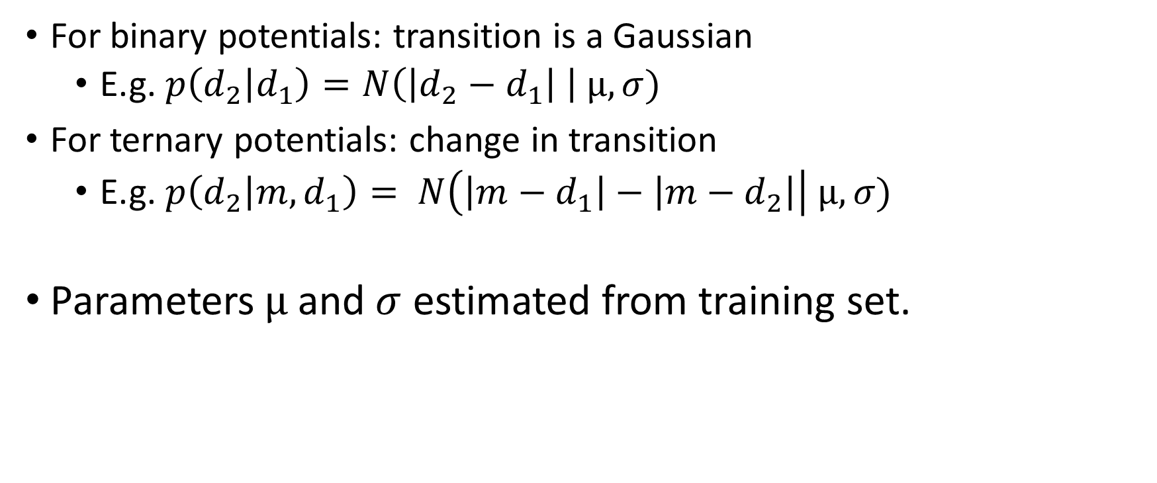
Higher-order potentials modeling
For binary potentials: transition is a Gaussian
E.g. $p\left(d_{2} | d_{1}\right)=N\left(\left|d_{2}−d_{1}\right| \right| µ, σ)$
For ternary potentials: change in transition
E.g. $p\left(d_{2} | {m, d}_{1}\right)= N\left(\left|m−d_{1}\right|−\left|m−d_{2}\right|\right| µ, σ)$
Parameters $µ$ and $σ$ estimated from training set.
Notes:
Higher order potentials are just conditional probabilities of one cell location given other cell or cells. We can say that transition between two cells is a Gaussian.

Slide 18
Detection of mitosis: the workflow
Input: consecutive frames $t_{1}$ and $t_{2}$
Extract feature sets $f^{m}$ and $f^{d}$
Model higher-order potentials (e.g. $p^{{d_{2}d}_{1}}\left(d_{2} | d_{1}\right)$)
Train two random forests:
one for mother, one for daughter
Estimate parameters of models
Unary potentials:
$$p_{RF}^{m}\left(f^{m}|t_{1}\text{,}t_{2}\right)$$
$$p_{RF}^{d}(f^{d}|t_{1}\text{,}t_{2})$$
Binary and
ternary potentials:
$$p^{{d_{2}d}_{1}}\left(d_{2} | d_{1}\right)$$
$$p^{d_{2}md_{1}}\left(d_{2} | m, d_{1}\right)$$
etc.
Estimate joint probability
Conditional Random Field (CRF):
$$p_{CRF}(m, d_{1},d_{2}|t_{1}\text{,}t_{2})=\frac{1}{Z}exp⁡(\sum_{A}{w^{A}p^{A}})$$
Alternative:
Bayes’ theorem
Learn weights $w^{A}$ of potentials using maximum likelihood
Output: sets of tuples $(m, d_{1},d_{2})$ with $p_{CRF}\left(m, d_{1},d_{2} | t_{1},t_{2}\right)>threshold$
Notes:
Here comes necessity of modeling interdependencies between cell locations

Slide 19
Detection of mitosis: the workflow
Input: consecutive frames $t_{1}$ and $t_{2}$
Extract feature sets $f^{m}$ and $f^{d}$
Model higher-order potentials (e.g. $p^{{d_{2}d}_{1}}\left(d_{2} | d_{1}\right)$)
Train two random forests:
one for mother, one for daughter
Estimate parameters of models
Unary potentials:
$$p_{RF}^{m}\left(f^{m}|t_{1}\text{,}t_{2}\right)$$
$$p_{RF}^{d}(f^{d}|t_{1}\text{,}t_{2})$$
Binary and
ternary potentials:
$$p^{{d_{2}d}_{1}}\left(d_{2} | d_{1}\right)$$
$$p^{d_{2}md_{1}}\left(d_{2} | m, d_{1}\right)$$
etc.
Conditional Random Field (CRF):
$$p_{CRF}(m, d_{1},d_{2}|t_{1}\text{,}t_{2})=\frac{1}{Z}exp⁡(\sum_{A}{w^{A}p^{A}})$$
Alternative:
Bayes’ theorem
Learn weights $w^{A}$ of potentials using maximum likelihood
Output: sets of tuples $(m, d_{1},d_{2})$ with $p_{CRF}\left(m, d_{1},d_{2} | t_{1},t_{2}\right)>threshold$
Notes:
Here is the workflow of mitosis detection. Suppose I have consecutive frame t1 and t2 as input
The first thing I do I extract two sets of features: one which is relevant for mother cell detection, another for daughter
Then I train two random forest classifiers separately for mother detection, separately for daughter.
At the same time I’ll consider higher order potentials, that is dependencies between cell locations. I’ll model them with normal distribution. Then I’ll estimate distribution parameters for each potential.
Now when I have this components I can model joint probability of mother and two daughters.
I have two alternatives to do so. A more naïve and simpler one is to use Bayes theorem
Another and more powerful alternative is to use graphical models, in particular conditional random field.
My joint distribution is exponent of a weighted sum of potentials. Weights will be learned with maximum likelihood
The output is tuples of three points with joint prob. Higher than some threshold.

Slide 20
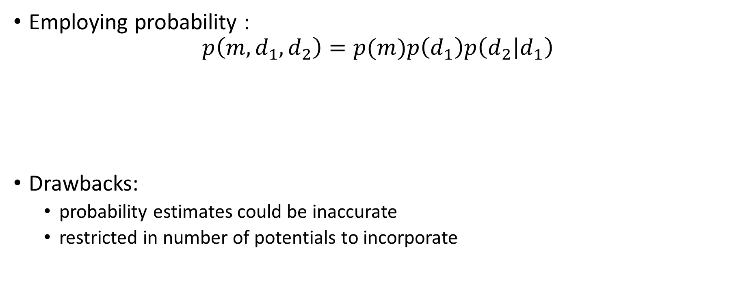



Estimating joint probability: Bayes
Employing probability :
$$p\left(m, d_{1}, d_{2}\right)=p(m)p\left(d_{1}\right)p\left(d_{2} | d_{1}\right)$$
Drawbacks:
probability estimates could be inaccurate
restricted in number of potentials to incorporate
$$p_{RF}^{m}\left(f^{m}(m){|t}_{1}\text{,}t_{2}\right)$$
$$p_{RF}^{d}\left(f^{d}(d){|t}_{1}\text{,}t_{2}\right)$$
$$N\left(\left|d_{2}−d_{1}\right| \right| µ, σ)$$
Notes:
Restricted only to three potentials I can incorporate. As they could be inaccurate due to classifier or too simplified modeling of higher order.

Slide 21
Detection of mitosis: the workflow
Input: consecutive frames $t_{1}$ and $t_{2}$
Extract feature sets $f^{m}$ and $f^{d}$
Model higher-order potentials (e.g. $p^{{d_{2}d}_{1}}\left(d_{2} | d_{1}\right)$)
Train two random forests:
one for mother, one for daughter
Estimate parameters of models
Unary potentials:
$$p_{RF}^{m}\left(f^{m}|t_{1}\text{,}t_{2}\right)$$
$$p_{RF}^{d}(f^{d}|t_{1}\text{,}t_{2})$$
Binary and
ternary potentials:
$$p^{{d_{2}d}_{1}}\left(d_{2} | d_{1}\right)$$
$$p^{d_{2}md_{1}}\left(d_{2} | m, d_{1}\right)$$
etc.
Conditional Random Field (CRF):
$$p_{CRF}(m, d_{1},d_{2}|t_{1}\text{,}t_{2})=\frac{1}{Z}exp⁡(\sum_{A}{w^{A}p^{A}})$$
Alternative:
Bayes’ theorem
Learn weights $w^{A}$ of potentials using maximum likelihood
Output: sets of tuples $(m, d_{1},d_{2})$ with $p_{CRF}\left(m, d_{1},d_{2} | t_{1},t_{2}\right)>threshold$
Notes:
Here is the workflow of mitosis detection. Suppose I have consecutive frame t1 and t2 as input
The first thing I do I extract two sets of features: one which is relevant for mother cell detection, another for daughter
Then I train two random forest classifiers separately for mother detection, separately for daughter.
At the same time I’ll consider higher order potentials, that is dependencies between cell locations. I’ll model them with normal distribution. Then I’ll estimate distribution parameters for each potential.
Now when I have this components I can model joint probability of mother and two daughters.
I have two alternatives to do so. A more naïve and simpler one is to use Bayes theorem
Another and more powerful alternative is to use graphical models, in particular conditional random field.
My joint distribution is exponent of a weighted sum of potentials. Weights will be learned with maximum likelihood
The output is tuples of three points with joint prob. Higher than some threshold.

Slide 22












Conditional Random Field (CRF) formulation [12, 13]
$$x$$
$U = \left\{m, d_{1}, d_{2}\right\}$
$B=\left\{\left(m,d_{1}\right),\left(m,d_{2}\right), \left(d_{1},d_{2}\right)\right\}$
$T = \{(m, d_{1},d_{2})\}$
$$p\left(m, d_{1},d_{2} | x\right)=\frac{1}{Z(x)}\prod_{i∊U}{ψ_{i}\left(i, x\right)}\prod_{(i, j)∊B}{ψ_{ij}(i, j)}\prod_{(i, j, k)∊T}{ψ_{ijk}(i, j, k)}$$
$${ ψ}_{d_{1}}$$
$${ ψ}_{m}$$
$${ ψ}_{d_{2}}$$
$${ d}_{1}$$
$${ ψ}_{md_{1}}$$
$${ ψ}_{md_{2}}$$
$$m$$
$${ ψ}_{md_{1}d_{2}}$$
$${ d}_{2}$$
$${ ψ}_{d_{1}d_{2}}$$
[12] Lafferty et al. 2001. Conditional random fields: Probabilistic models for segmenting and labeling sequence data. International Conference on Machine Learning. [13] Sutton et al. 2010. An Introduction to Conditional Random Fields.
Notes:
Undirected graphical model. Interdependencies bw variables modeled by factors. A normalized product of this factors is our joint probability.

Slide 23

CRF formulation: factors
Unary factors:
$$ψ_{m}\left(m,x\right)=\exp{\{w_{m}p\left(m\right)\}}$$
Binary factors:
$$ψ_{d_{1}d_{2}}\left(d_{1},d_{2},x\right)=\exp\left\{w_{d_{1}d_{2}}p\left(d_{1} | d_{2}\right)\right\}$$
Ternary factors:
$$ψ_{{md}_{1}d_{2}}\left(m,d_{1},d_{2},x\right)=exp⁡\{w_{{md}_{1}d_{2}}p(m|d_{1},d_{2})\}$$
Notes:
Each factor is a exponent to the power of weighted potential.

Slide 24

CRF formulation: learn weights
In some works weights are chosen empirically. [14]
Disadvantages:
Requires time to tune
May be inaccurate
Better option: learn weights by maximizing likelihood [15]:
$$\hat{w}={\arg{max}}_{w}\prod_{\left\{n=1\right\}}^{N}{p\left(m^{n},d_{1}^{n}, d_{1}^{n} | x^{n}\right)=\prod_{\left\{n=1\right\}}^{N}{\frac{1}{Z}exp⁡(\sum_{A}{w^{A}p_{n}^{A}})} }$$
$m^{n},d_{1}^{n}, d_{1}^{n}$ - labels of $n$th sample $x^{n}$
Positive samples: annotated cell divisions; negative samples: random triples
[14] Wang et al. 2013. Landmark detection and coupled patch registration for cardiac motion tracking. SPIE. [15] Wang et al. 2015. Anatomic-Landmark Detection Using Graphical Context Modelling.

Slide 25


Detection of mitosis: the workflow
Input: consecutive frames $t_{1}$ and $t_{2}$
Extract feature sets $f^{m}$ and $f^{d}$
Model higher-order potentials (e.g. $p^{{d_{2}d}_{1}}\left(d_{2} | d_{1}\right)$)
Train two random forests:
one for mother, one for daughter
Estimate parameters of models
Unary potentials:
$$p_{RF}^{m}\left(f^{m}|t_{1}\text{,}t_{2}\right)$$
$$p_{RF}^{d}(f^{d}|t_{1}\text{,}t_{2})$$
Binary and
ternary potentials:
$$p^{{d_{2}d}_{1}}\left(d_{2} | d_{1}\right)$$
$$p^{d_{2}md_{1}}\left(d_{2} | m, d_{1}\right)$$
etc.
Conditional Random Field (CRF):
$$p_{CRF}(m, d_{1},d_{2}|t_{1}\text{,}t_{2})=\frac{1}{Z}exp⁡(\sum_{A}{w^{A}p^{A}})$$
Alternative:
Bayes’ theorem
Learn weights $w^{A}$ of potentials using maximum likelihood
Output: sets of tuples $(m, d_{1},d_{2})$ with $p_{CRF}\left(m, d_{1},d_{2} | t_{1},t_{2}\right)>threshold$
Notes:
Here is the workflow of mitosis detection. Suppose I have consecutive frame t1 and t2 as input
The first thing I do I extract two sets of features: one which is relevant for mother cell detection, another for daughter
Then I train two random forest classifiers separately for mother detection, separately for daughter.
At the same time I’ll consider higher order potentials, that is dependencies between cell locations. I’ll model them with normal distribution. Then I’ll estimate distribution parameters for each potential.
Now when I have this components I can model joint probability of mother and two daughters.
I have two alternatives to do so. A more naïve and simpler one is to use Bayes theorem
Another and more powerful alternative is to use graphical models, in particular conditional random field.
My joint distribution is exponent of a weighted sum of potentials. Weights will be learned with maximum likelihood
The output is tuples of three points with joint prob. Higher than some threshold.

Slide 26

The schedule

Slide 27
References
[1] Barker, N., van de Wetering, M., and Clevers, H. 2008. The intestinal stem cell. Genes & Dev. 22:1856-1864.
[2] Crosnier, C., Stamataki, D., Lewis, J. 2006. Organizing cell renewal in the intestine: stem cells, signals and combinatorial control. Nature Reviews Genetics. 7(5):349-359.
[3] Yeung, T.M., Chia, L.A., Kosinski, C.M., Kuo, C.J. 2011. Regulation of self-renewal and differentiation by the intestinal stem cell niche. Cellular and Molecular Life Sciences. Vol. 68, no. 15, pp. 2513–2523.
[4] Cootes, T.F., Taylor, C. J. 2000. Statistical Models of Appearance for Computer Vision.
[5] Flood fill Wikipedia: https://en.wikipedia.org/wiki/Flood_fill
[6] Suzuki, S. (1985). Topological structural analysis of digitized binary images by border following. Computer Vision, Graphics, and Image Processing, 30(1), 32-46.
[7] Cubic Spline on Wolfram: http://mathworld.wolfram.com/CubicSpline.html
[8] Template Matching Techniques in Computer Vision: Theory and Practice. Roberto Brunelli. March 2009. ISBN: 978-0-470-51706-2
[9] Dalal, N., & Triggs, B. (2005, June). Histograms of oriented gradients for human detection. In Computer Vision and Pattern Recognition, 2005. CVPR 2005. IEEE Computer Society Conference on (Vol. 1, pp. 886-893). IEEE.
[10] Distinctive image features from scale-invariant keypoints. David G. Lowe, International Journal of Computer Vision, 60, 2 (2004), pp. 91-110.
[11] Christopher M. Bishop, Pattern Recognition and Machine Learning. Springer, Berlin, New York, 2006.
[12] Lafferty, J., McCallum, A., Pereira, F. 2001. Conditional random fields: Probabilistic models for segmenting and labeling sequence data. Proceedings of 18th International Conference on Machine Learning.
[13] Sutton, C., McCallum, A. 2010. An Introduction to Conditional Random Fields. v1. arXiv:1011.4088.
[14] H. Wang, W. Shi, X. Zhuang, X. Wu, K. Tung, S. Ourselin, P. Edwards, and D. Rueckert, “Landmark detection and coupled patch registration for cardiac motion tracking,” in SPIE, 2013, vol. 8669.
[15] Wang, L., Belagiannis, V., Marr, C., Theis, F., Yang, G., Navab, N. 2015. Anatomic-Landmark Detection Using Graphical Context Modelling.

